Slide 1
TensorFlow Basics

Slide 2


Google Colab (Colaboratory)
Cloud-based jupyter notebook environment
Offers computing resources like CPU, GPU, and TPU for ML, DL, or data analysis.
Advantages
Beginner friendly
Great performance
Fast development
Disadvantages
Limited hardware availability and memory usage
Might have version conflict between Python and packages
Varying GPU resources

Slide 3
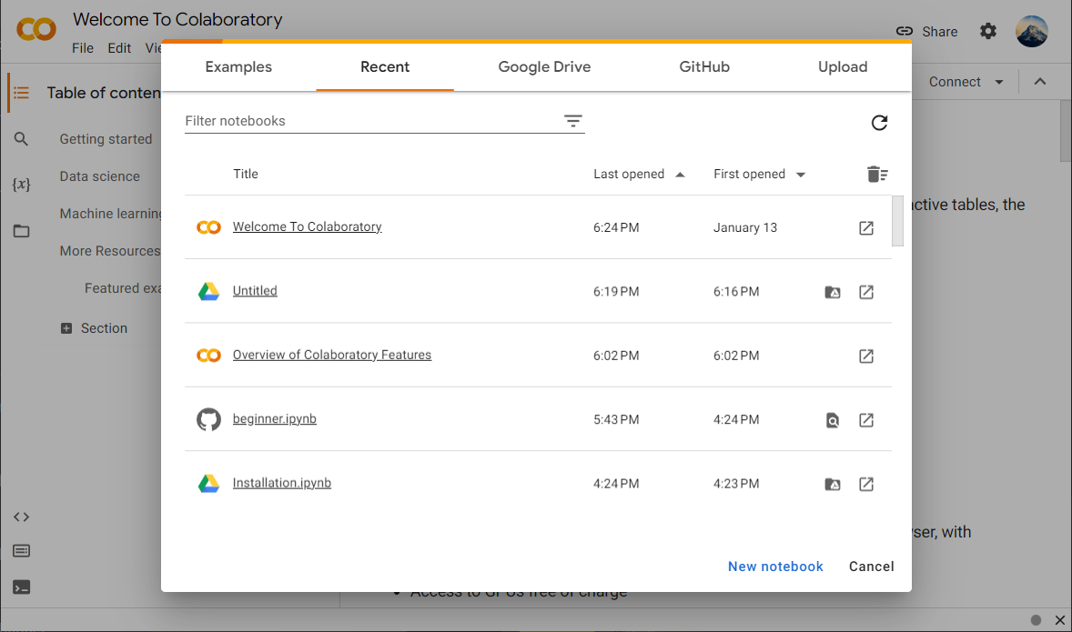
Google Colab
Go to Google Colab Official Site to create a new notebook

Slide 4
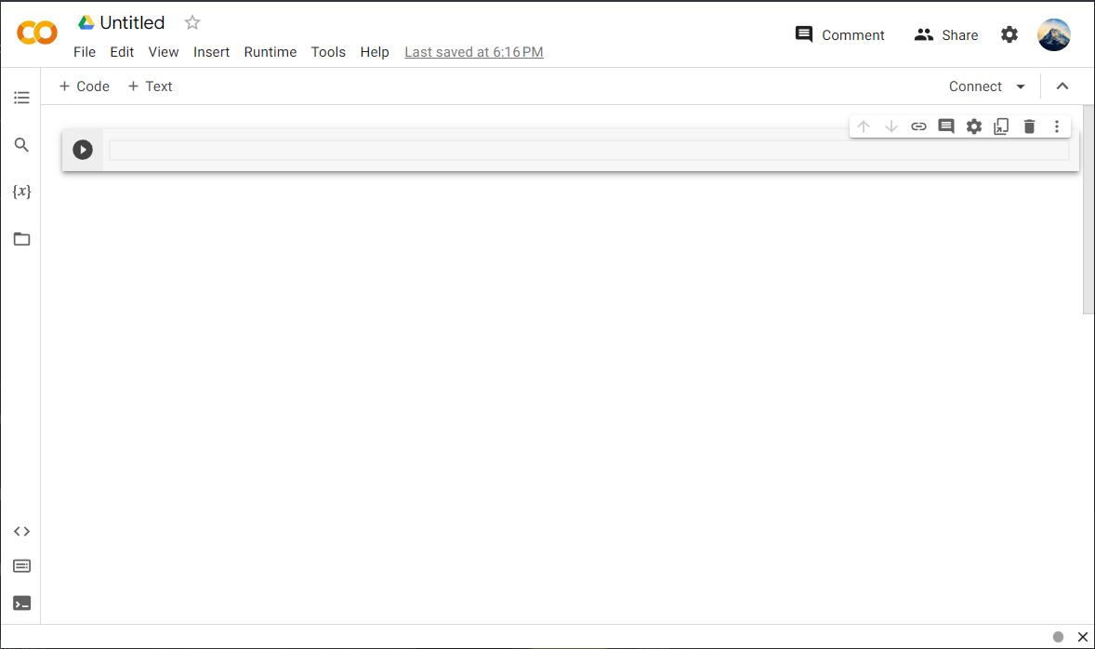
Google Colab
Try create and edit a cell, then run it by clicking the run button or delete it with the trash can symbol

Slide 5
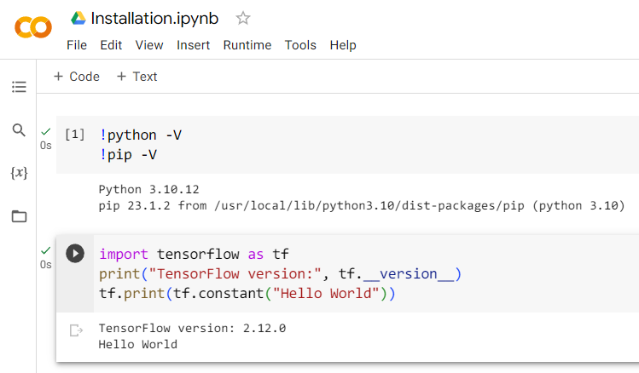
Google Colab
Google Colab use Python3 kernel by default, You can use !python -V and !pip -V to check the version
It also comes with plenty of pre-installed libraries, e.g. TensorFlow, Numpy, Pandas, etc.
Therefore, you can just type “import tensorflow as tf” to import TensorFlow with the alias “tf”
The source code in this tutorial is available from here

Slide 6



TensorFlow: Environment
For beginners, our recommendation is to opt for Google Colab due to its user-friendly interface and ease of use.
Otherwise, you can follow the guide provided in the following slides to install Python on your system and utilize pip to
install TensorFlow on Windows 10, using Visual Studio Code (VSCode) as the selected code editor.
To write the code, you can either use a text editor or an IDE:
Text editor: VSCode, Notepad++, ….
IDE: PyCharm, Spyder, ….

Slide 7
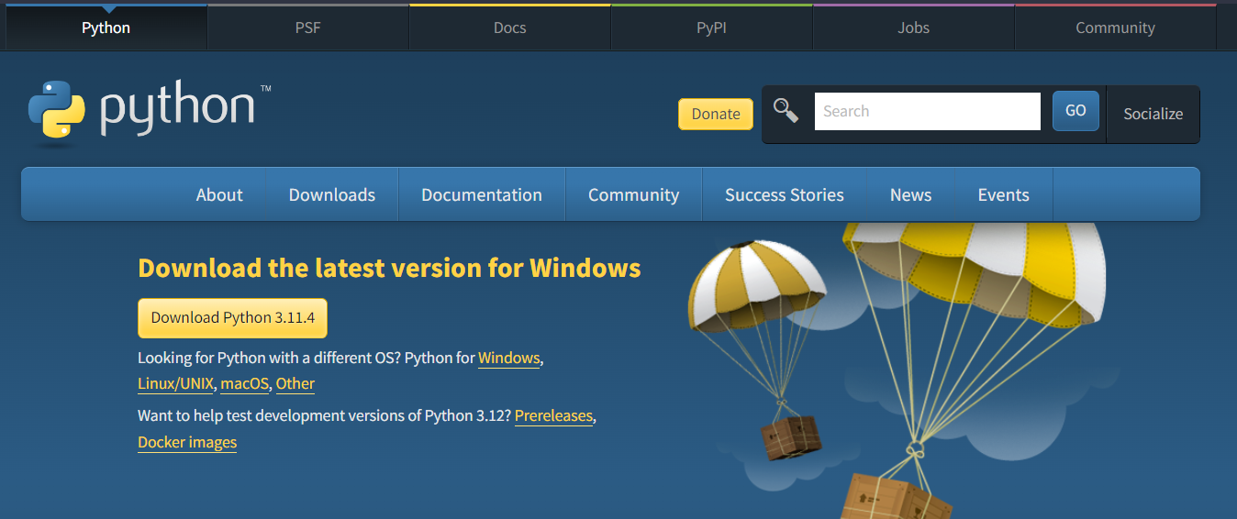
Python Installation
Another approach is to install Python and TensorFlow manually:
Download Python installer from Official Python Website

Slide 8
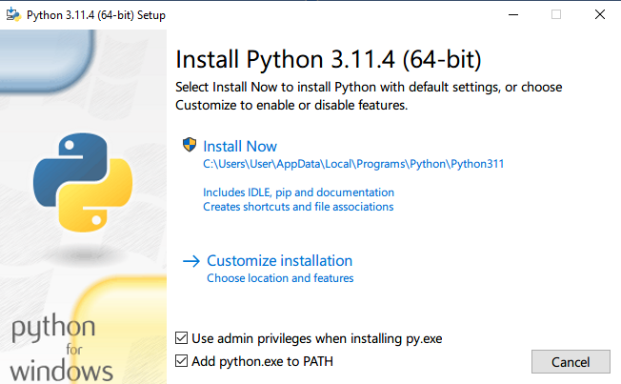
Python Installation
Run the executable installer to install Python on your computer

Slide 9
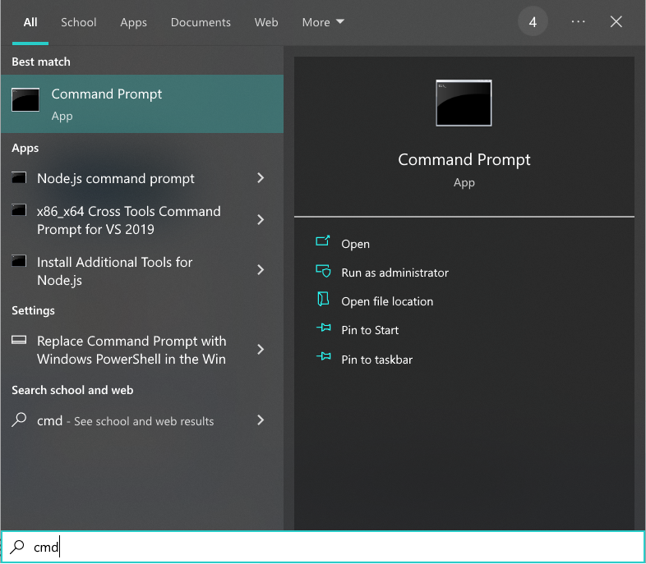
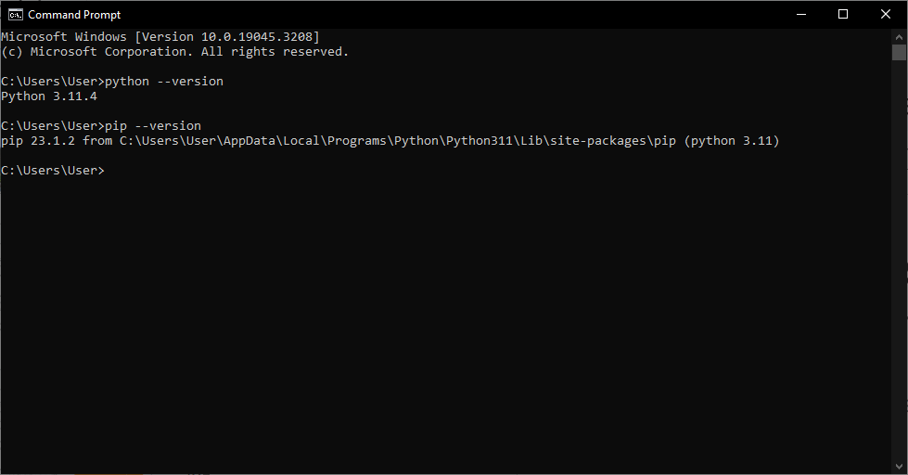
Verifying the Installation
Open “Command Promt” from Start Menu, then use the following commands to verify the installation.
python –version
pip –version
If the version information of Python and Pip are displayed correctly, then you are good to go!

Slide 10
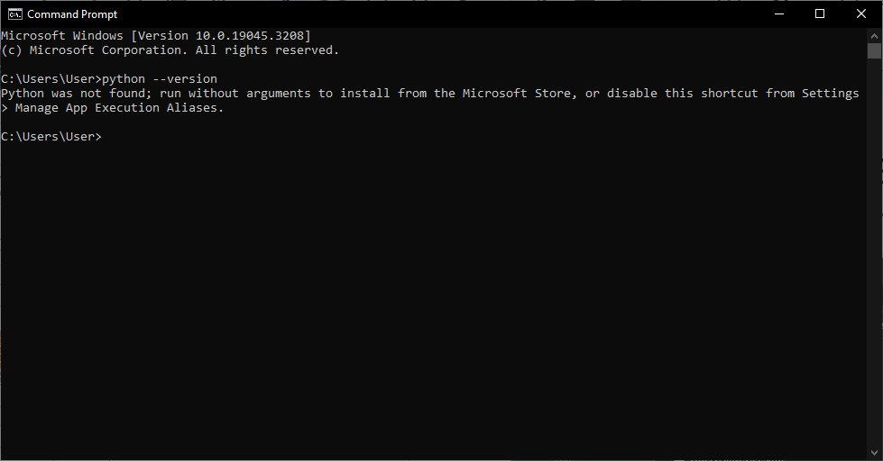
Troubleshooting
If you receive some messages like these: Python was not found…, Python is not recognized…
It might caused by a failed installation or a success installation without adding Python into PATH (Environment Variable)

Slide 11
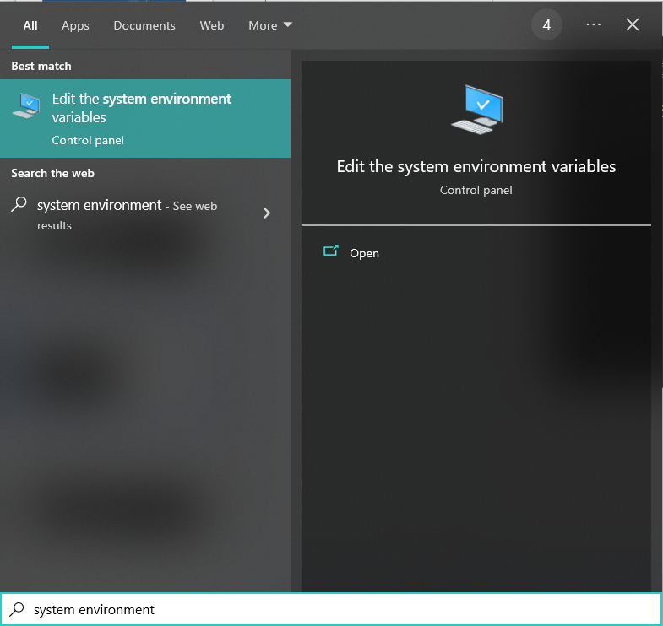
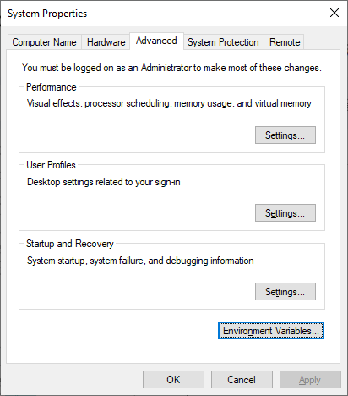
Troubleshooting
Open “Edit the system environment variables” from Start Menu

Slide 12
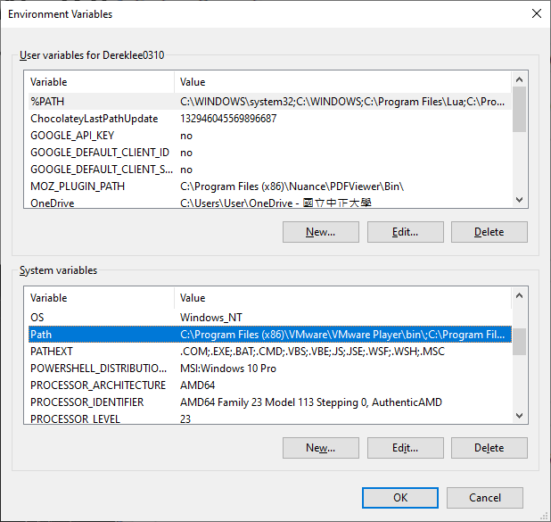
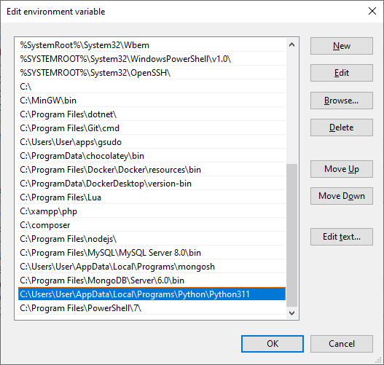
Troubleshooting
Click on the system variable “Path” and use “New” to add a new environment variable
The path of python.exe might be different from one computer to another

Slide 13
Troubleshooting
Now reopen the command prompt to see if the python is successfully installed.
(A reboot of your computer might be required)

Slide 14
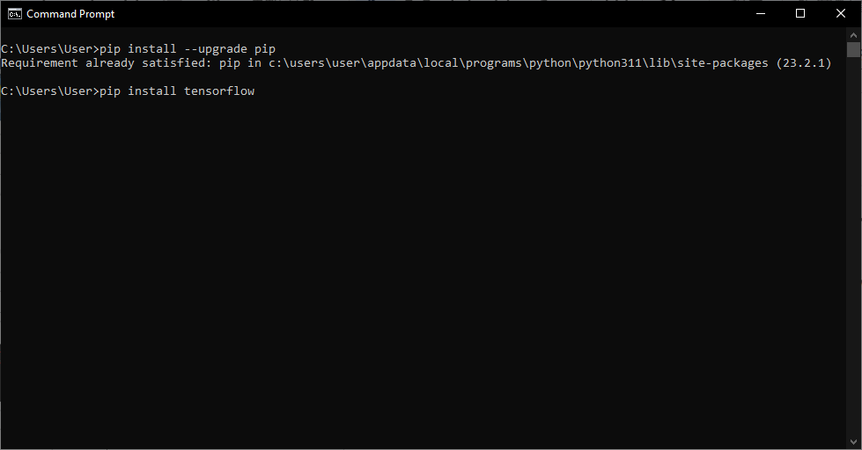
TensorFlow Installation
Now, we can install TensorFlow 2 (latest version) through pip using following commands:
pip install --upgrade pip
pip install tensorflow

Slide 15
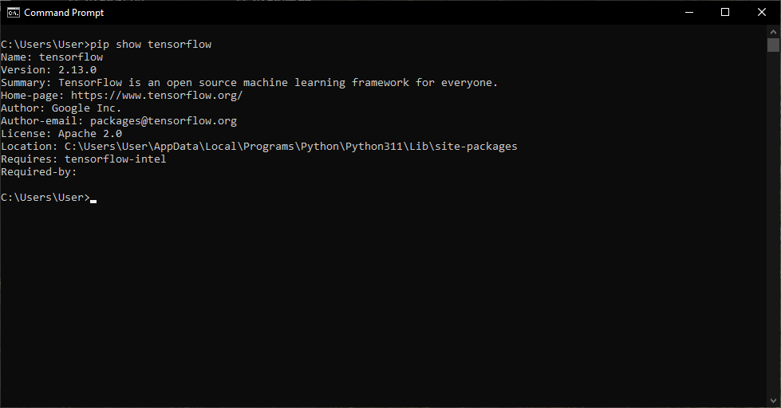
TensorFlow Installation
Check if TensorFlow is installed.
pip show tensorflow

Slide 16
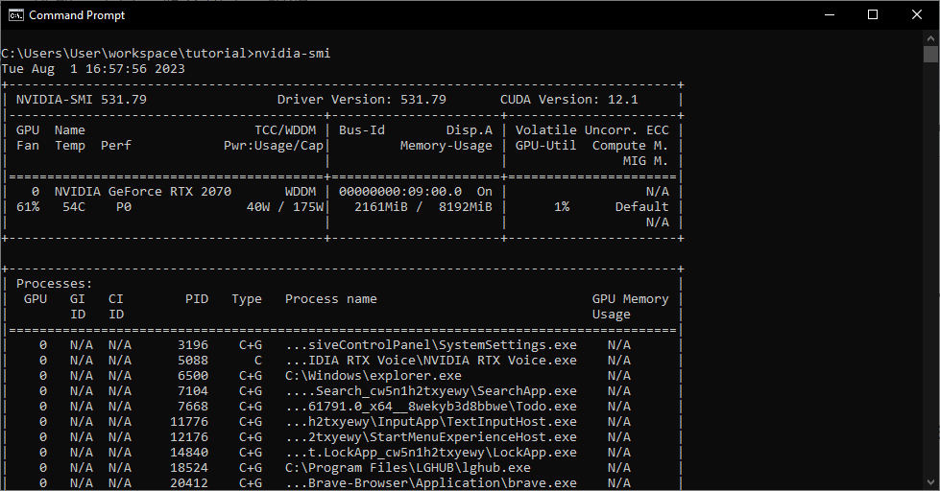
TensorFlow Installation
Use command “nvidia-smi” to check your GPU model
If you have a CUDA enabled GPU, you can install CUDA and cuDNN following the instructions to accelerate model training

Slide 17
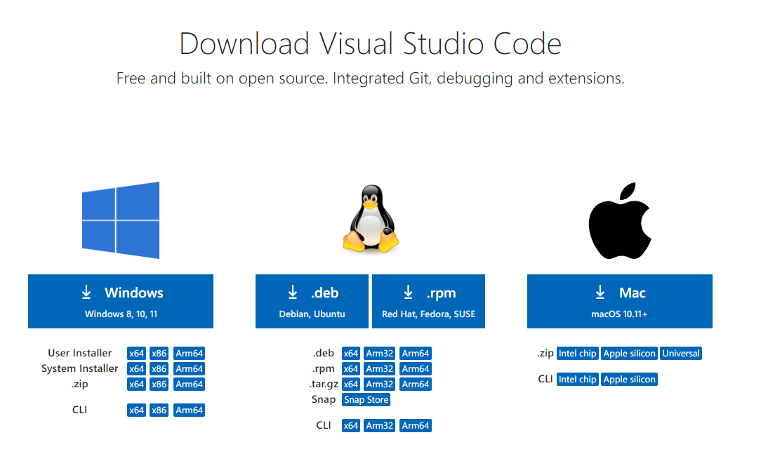
VSCode Installation
In addition,you will need a code editor to write your code:
Download VSCode from Official Website

Slide 18
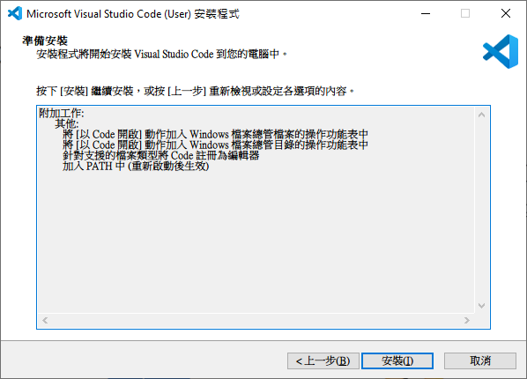
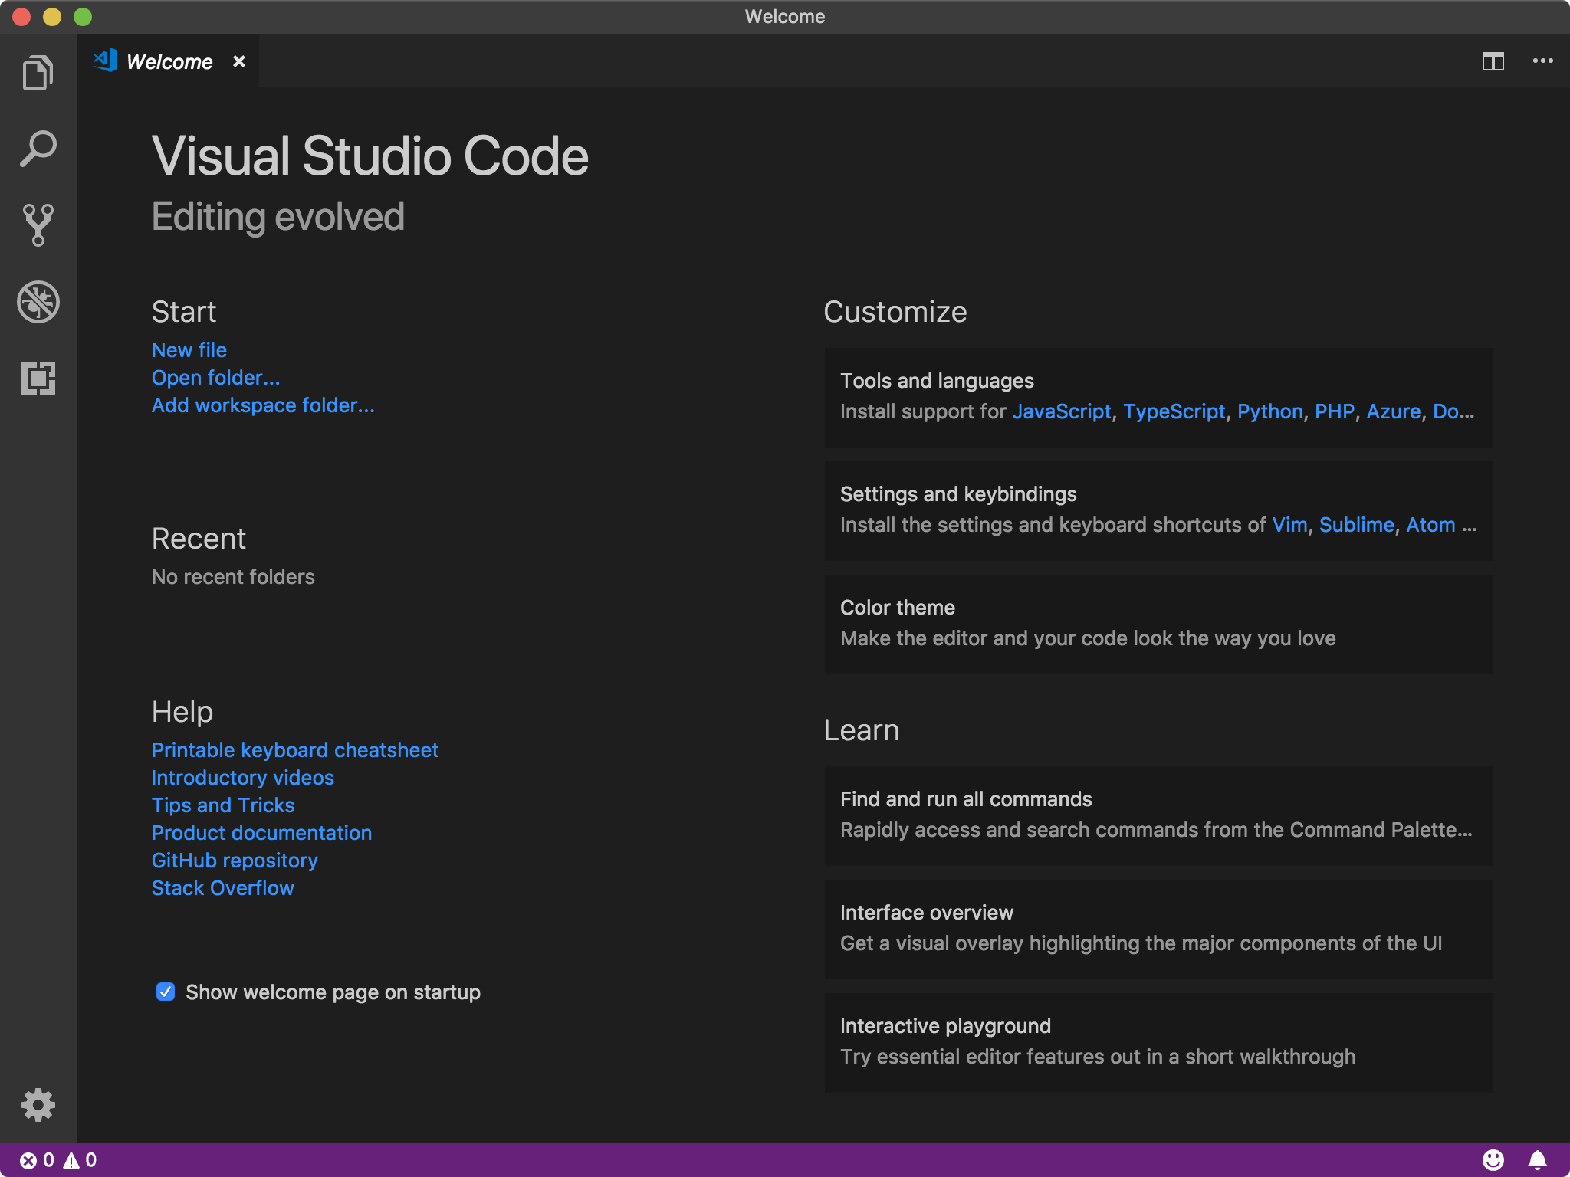
VSCode Installation
Run the executable installer to install it
Your editor might look slightly different from this one

Slide 19
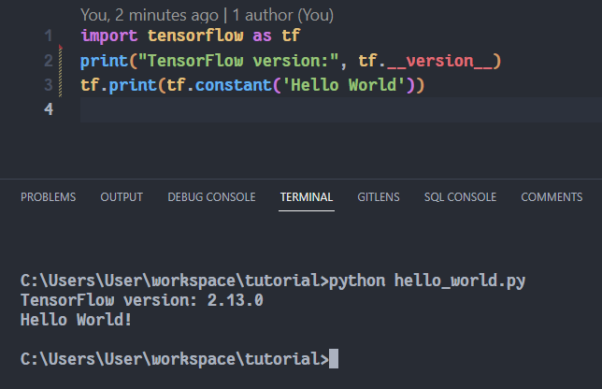
TensorFlow: Hello World
Finally, we conclude this section with a simple hello world program:
The source code in this tutorial is available from here

Slide 20
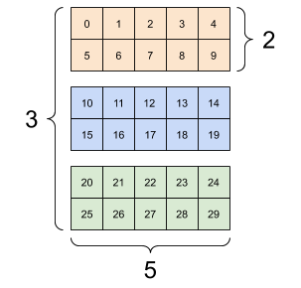
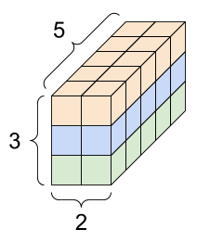
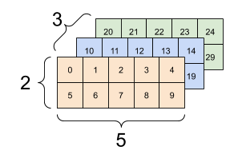
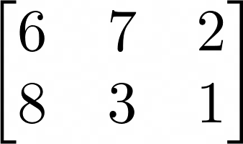

What is Tensor
In TensorFlow, all the computations are based on tensors.
You might be familiar with vectors and matrices:
A vector and a matrix
An 3-dimensional tensor
In fact, you were working with both 1-dimensional and 2-dimensional tensors,
which correspond to vectors and matrices.
Thus, a tensor is just a multi-dimensional array with uniform data type.
https://www.tensorflow.org/guide/tensor

Slide 21
Data Type
A tensor’s attribute “dtype” indicates its data type. these data types are not defined by Python but TensorFlow.
Boolean
tf.bool
Signed Integers
tf.int8
tf.int16
tf.int32
tf.int64
Unsigned Integers
tf.uint8
tf.uint16
Floating-point Numbers
tf.float16
tf.float32
tf.float64 (tf.double)
String
tf.string
Complex Number
tf.complex64
tf.complex128

Slide 22

Types of Tensors
1. Constant
Storing typical data that cannot be changed in the future
2. Variable
Must be initialized
Used for parameters to learn
The values vary during the training
3. Placeholder
Initialization is not required
Used for feeding actual training examples
The values vary during the training
variable
placeholder
variable
Example: Linear Regression
tf.Tensor
tf.Variable
tf.constant
tf.placeholder

Slide 23
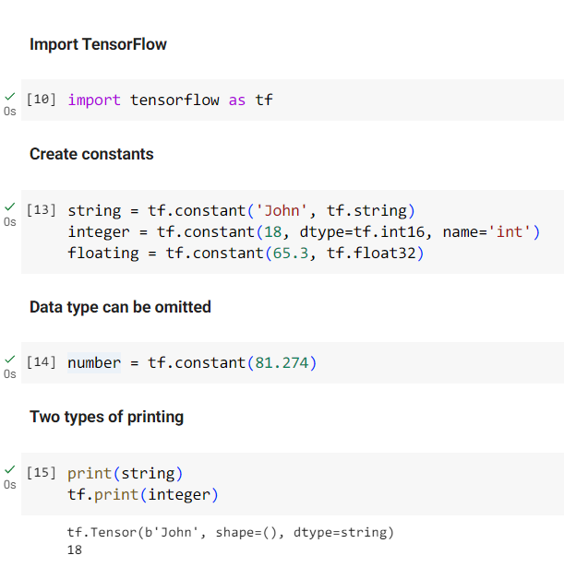
Constant
You should specify the data type when you create a
constant.
If the data type is not specified, then TensorFlow will do
the job for you.
Both print() and tf.print() works fine with tensors.

Slide 24
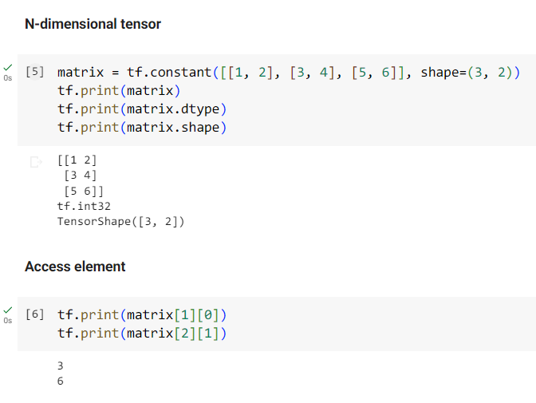
Constant
A Tensor’s value and attributes can also be
printed out respectively for debugging.
Just like the list in Python, you can get the items
in tensor using square brackets
We will talk about some advanced techniques for
tensor manipulation later

Slide 25
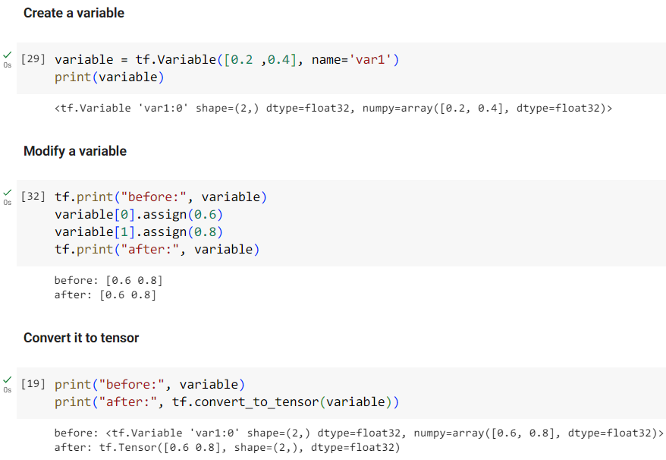
Variable
The name parameter is used in
the TensorFlow namespace
rather than the Python one.
Use variable’s assign() method
to assign a new value .
You can convert them to tensor
to reshape or perform other
operations on them.

Slide 26
Graph Execution
Before discussing placeholder and performing operations on tensors, it is
important to understand how those tensors flows in graph execution.
All computations are executed as a TensorFlow graph
A Node is a “tf.Operation” object, representing a computation unit
Data are encapsulated into “tf.tensor” objects.
Can’t get the result from a static graph before the compilation and execution.h
Hard to debug during the model construction.
Neural Network Demo
https://www.analyticsvidhya.com/blog/2016/10/an-introduction-to-implementing-neural-networks-using-tensorflow/

Slide 27
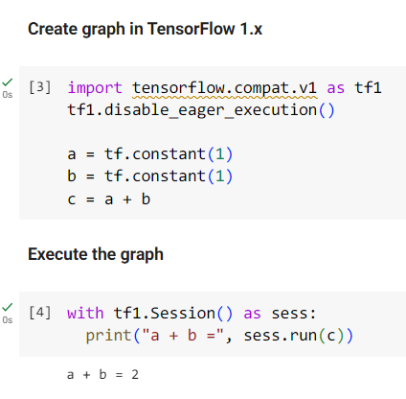
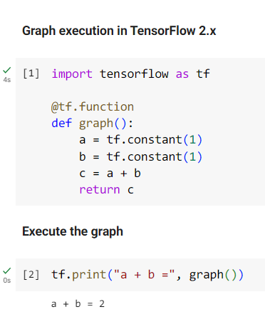
Comparison
This short demo shows you the difference of graph execution computing 1 + 1 in different version of TensorFlow.

Slide 28
Eager Execution
To enhance the development efficiency, a new mode called eager execution was introduced.
Evaluate operations immediately like an interpreter
Able to execute operations without building a static graph
Is the default execution mode in TensorFlow 2.x
Majorly used in this tutorial
During early development and debugging, it is a good practice to use eager execution to make your life easier.
However, when the model grows larger and larger, you might want to migrate to graph mode (which is easy) to
optimize your computational graph and improve your execution performance.

Slide 29
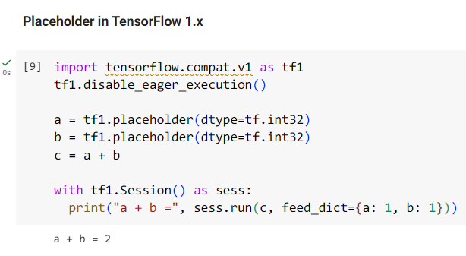
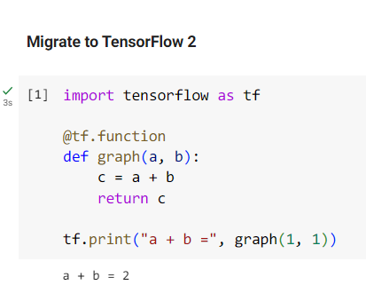
Placeholder
Using placeholder, we can pass tensors into the graph and compute the result.
In TensorFlow 2.x, placeholder is deprecated and replaced by the combination of AutoGraph and function.
In order to build a graph from a Python function, a decorator “@tf.function” is required.

Slide 30
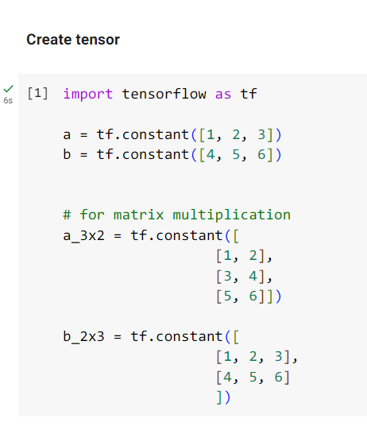
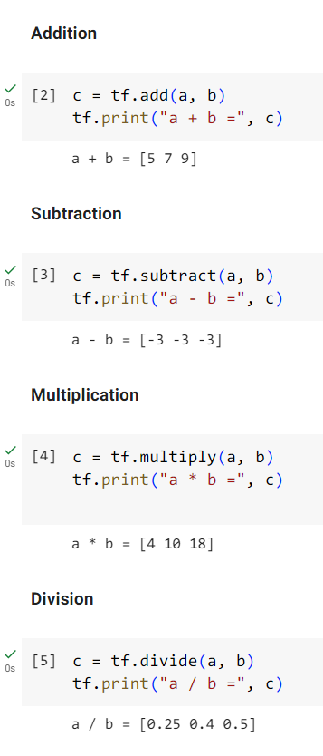
Arithmetic Operation
Notice that these operations are performed on tensors elementwisely

Slide 31
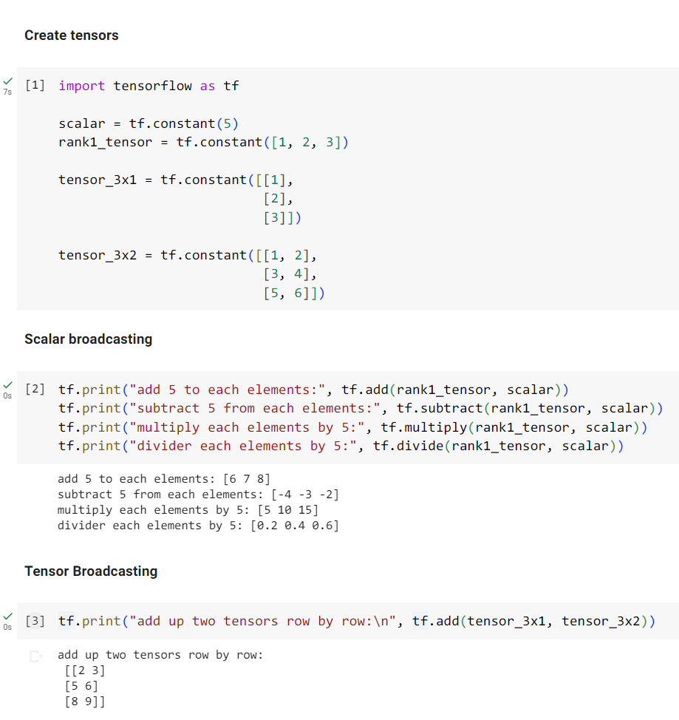
Broadcasting-1
Here are some constant that will be use in the next slides to showcase the power of broadcasting.

Slide 32
Broadcasting-2
Broadcasting provides an easy way to
perform arithmetic operations on tensors
with different shape without reshaping them.
The tensor that has smaller rank will be
expanded automatically to match the shape
of the other tensor.

Slide 33
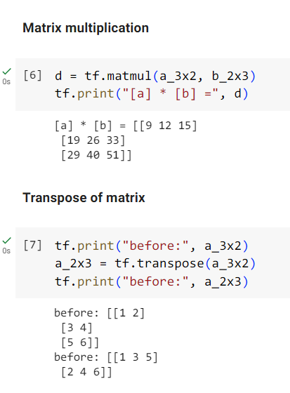
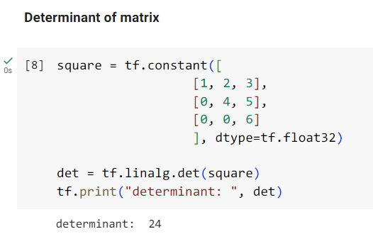
Matrix Operation
Using data defined in the previous page, it demonstrates
a basic idea of how to multiply two matrices or caculate
the transpose and determinant of a matrix.

Slide 34
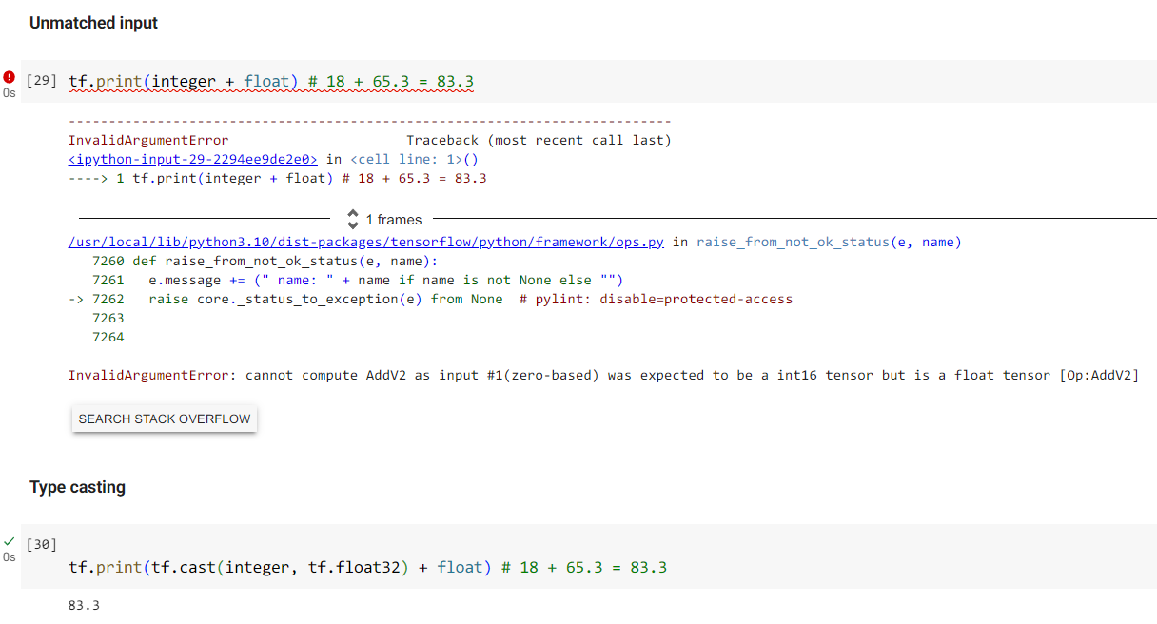
Common Mistake
If the data types of inputs doesn’t match, then it will cause an exception.

Slide 35
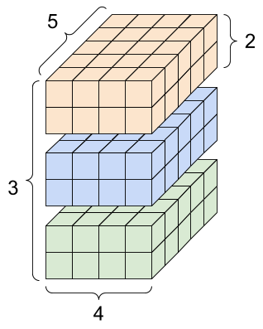
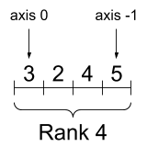
Rank and Axis
Here are some terminologies you need to know while manipulating tensors of higher dimension:
Shape: The number of elements of each of the axes
Rank: Number of axes
Axis: A particular dimension
Size: Total number of elements (product of the shape)
To understand its size, you can visualize it as the total volume of multiple cuboids.
Single cuboid: 2 * 4 * 5 = 40.
Total size: 3 * 40 = 120.
https://www.tensorflow.org/guide/tensor

Slide 36
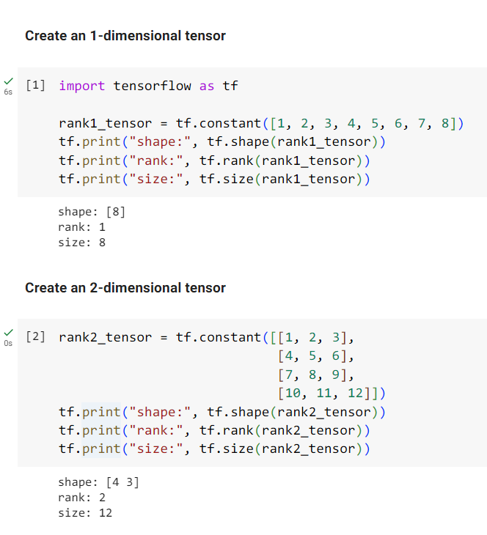
Rank and Axis
TensorFlow provides convenient built-in functions like
shape(), rank(), and size() to access a tensor’s properties.
In next slide, we will have a discussion about how to
access a single element or extract a sub-tensor from
tensors of one or higher dimensional.

Slide 37
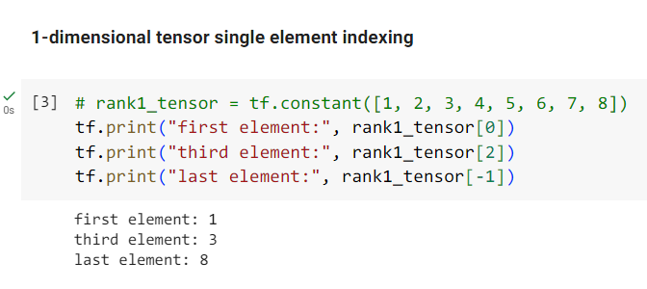
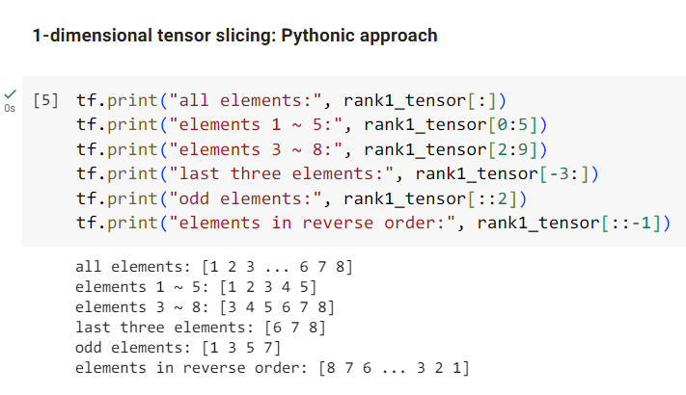
Indexing and Slicing
Use a square bracket with index to access a single element.
Negative indices count backwards from the end.
You can utilize colons with arguments to specify the slice you
desire in the format start:stop:step.
Initially, the values for slicing are set to 0 for the start, the
length of the tensor for the stop, and 1 for the step.

Slide 38
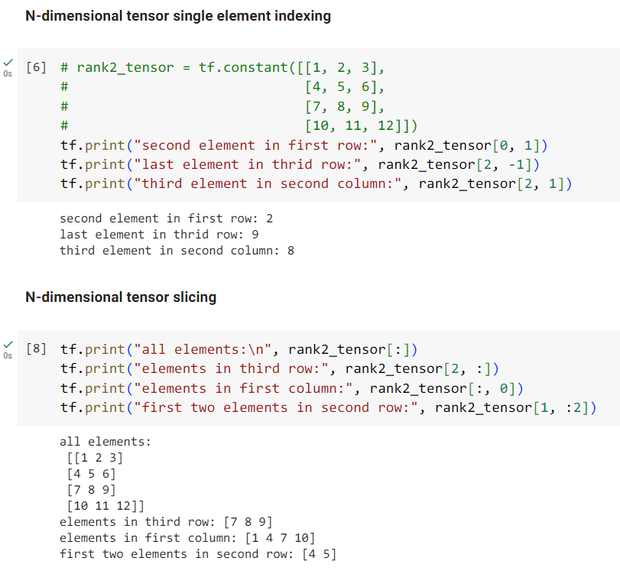
Indexing and Slicing
When dealing with higher-dimensional tensors, you
can use commas to separate the indices for each
axis.
It is entirely valid to use both integers and slices
simultaneously when indexing or slicing tensors. This
flexibility allows for precise control over the selection
of elements within the tensor.

Slide 39
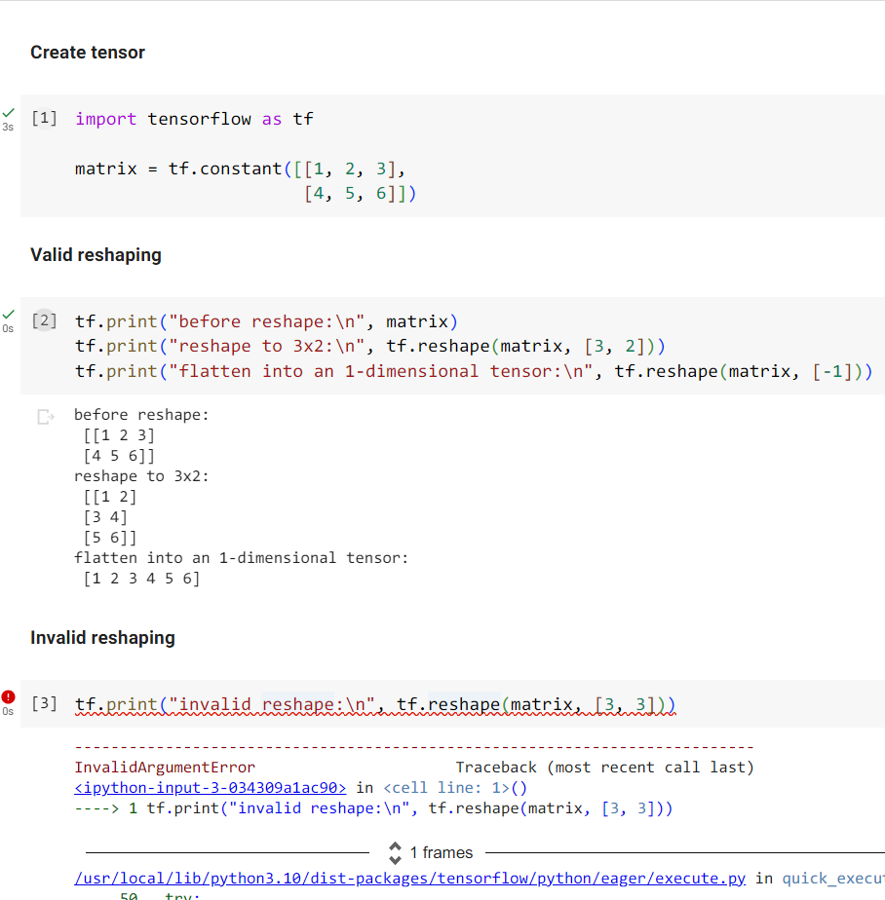
Reshaping
After reshaping a tensor in TensorFlow, the new
tensor will be filled in with the elements from the
original tensor in a row-major order, aligning with the
desired shape.
If you attempt to reshape a tensor in TensorFlow
into a new shape where the size of the new tensor
doesn't match the size of the current tensor, it will
raise an “InvalidArgumentError”.

Slide 40
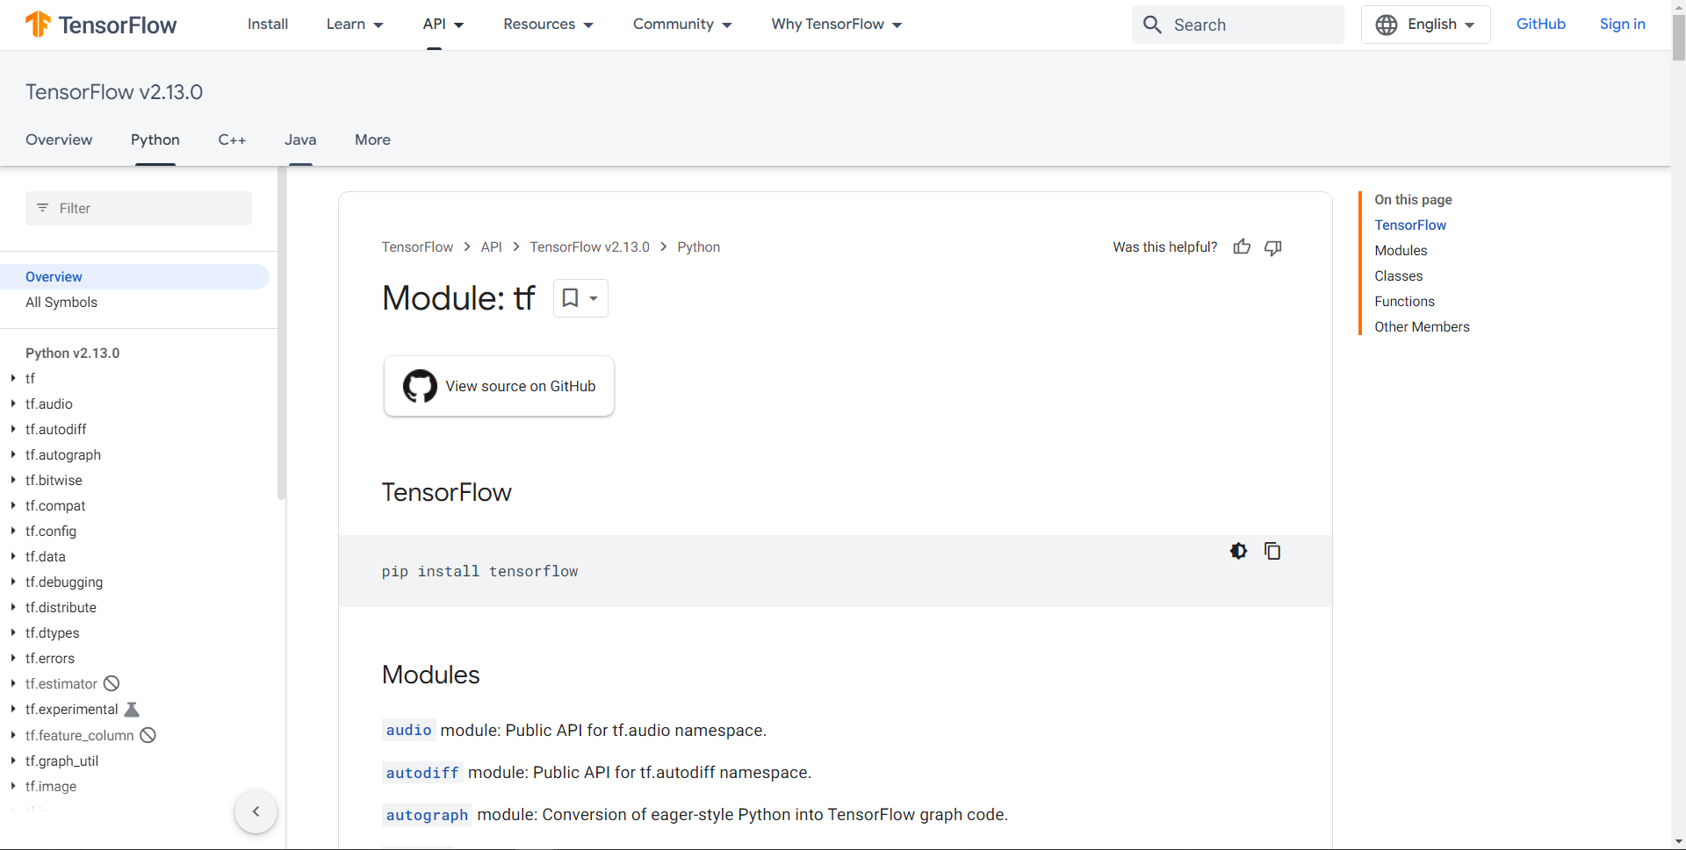
Appendix
For better understanding of the concept, please refer to the Official API documentation.
https://www.tensorflow.org/api_docs/python/tf

